Slide 1


Agent Development Framework and Commercialization Practices
From a Data Analyst's Perspective: End-to-End Analysis
作者：Ben Zhang

Slide 2
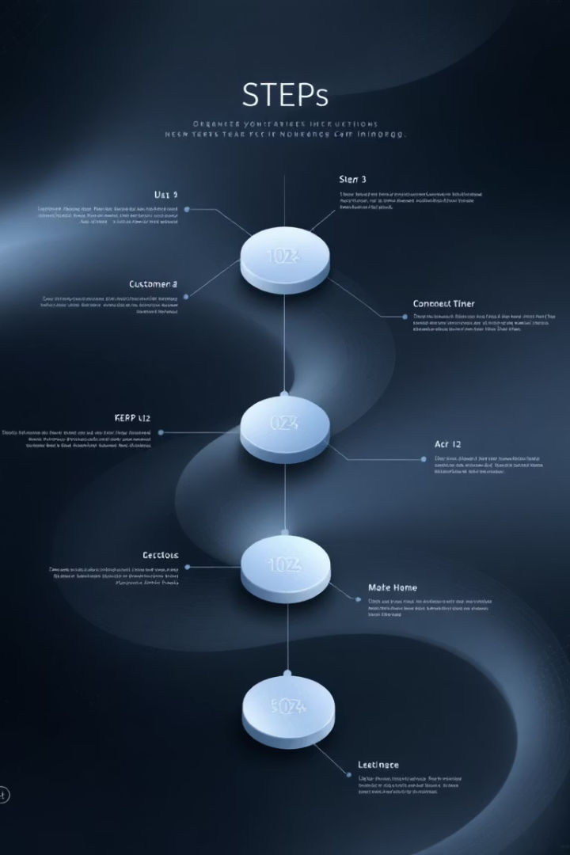




Agenda
AI Tool Stratification
From general-purpose to custom solutions
Commercial Framework Selection
The unique value of LangGraph
Visualization Practices
Full-process design of AI agents
Enterprise Application Scenarios
Implementing AI in internal environments

Slide 3
When Do We Need AI Agents?
AI-Driven Transformation
Heavy reliance on unstructured data: Scenarios that involve interpreting natural language, extract meaning from documents, or interacting with users conversationally
RAG
Dynamic report generation

Slide 4












Stratified AI Tool Applications
Programming Frameworks - Full customization
Custom Software - Lightweight LLM integration
General AI Tools - rapid daily task resolution
General AI Tools
Custom Software
Programming Frameworks
Rapid daily task resolution
Lightweight LLM integration
Full customization
International: OpenAI, Claude, Gemini
International: n8n(96.7k), langflow(61.9k)
International: Langchain (108k), AutoGen (44.8k), Crewai (31.8k)
Domestic: Doubao, Deepseek
Domestic: Coze
Domestic: PaddleAgent (22.8k), ModelScope-Agent (7.9k)

Slide 5
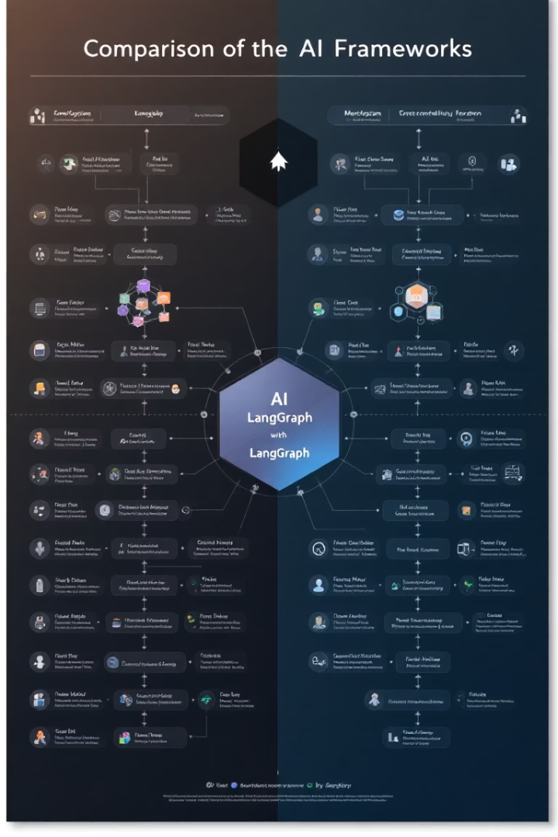
Framework Selection – Why LangGraph?
Dimension
LangChain
LangGraph
Autogen
Visualization
Code-driven
Flowchart design
Code-driven
Multi-Agent
Single-chain focus
Native collaboration
Custom protocols
Enterprise
Basic tools
RBAC & audit logs
Research-focused

Slide 6








Agent Design in LangGraph
Read CSV
Pandas Cleaning
Data ingestion
Data transformation
Database Storage
Quality Report
Persistent data
Validation checks

Slide 7

Enterprise Applications
Automated Analytics
CRM-BI Integration
Private KB Deployment
Monthly reports with anomaly detection
Behavioral data extraction to dashboards
Internal docs for instant metric answers

Slide 8
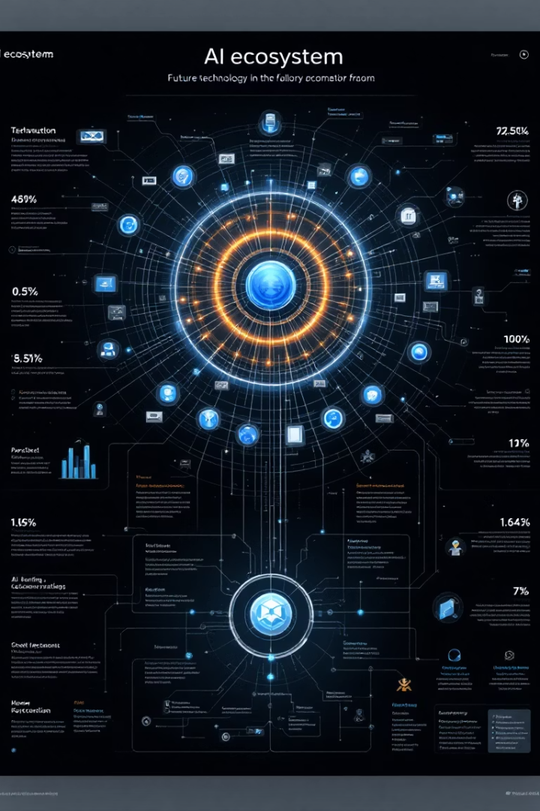
Conclusion & Vision
Tiered Implementation
General → Custom → Framework approach
Reduced Barriers
Visualization & multi-agent systems
Future Directions
Data lake integration, federated learning

Slide 9




Q&A
Data Security
Cost Control
Safeguards for enterprise implementation
Framework pricing and optimization
Technical Tiers
Choosing appropriate implementation level

